Slide 1
4th Year Membership Options
2 year APhA dual membership
The APhA Complete Review of Pharmacy, 13th edition
Shipping and handling waived
Access to NAPLEX review section of PharmacyLibrary
200 bonus member-only test prep questions
The new members only NAPLEX Review Study Guide that includes:
NABP Blueprint of topics covered on NAPLEX
List of the Top 200 Drugs
Pharmacy Mnemonics with illustrations
Discounted price with code DDS18 (save $10!)
Professional Liability Insurance
Must sign up prior to April 30th
Still have memberships with ASHP and PSW as well!

Slide 2
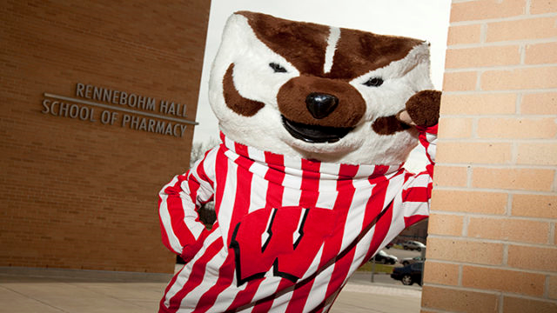
Campus Pharmacy Advocacy Day
WHO: All of your smiling faces
WHAT: Educate undergraduate students about the roles of pharmacists and spark interest in pharmacy school
WHERE: Various buildings on main campus
WHEN: April 13th (time TBD)
If you weren’t able to attend the planning meeting today and are still interested in helping plan the event please reach out to Elyse Keating, Sydney Stiener, Jordan Hilsenhoff, or Meredith Frey
More information to come!

Slide 3
ASHP Updates
March News
P&T Committee Meeting Sign-ups
ASHP CV Review- Submit by TOMORROW March 15th
Summer Meetings June 2-6th in Denver, CO
If interested in attending email me a short summary of why you would like to attend for the chance to receive complimentary registration!
Authors for ASJP Student Column- questions/inquiries students@ashp.org

Slide 4
PAA-WSPS Golf Outing 2018
Friday, June 8th 2018 – University Ridge Golf Course
Golfer information
$125 for students (discounted)
Round of golf, lunch, dinner, prizes
Sponsored Teams
PAA sponsored team, the Dean will sponsor a team, and WSPS will be co-sponsoring a team with Sarah Sorum
12 student-sponsored golfers! Here’s a link to be entered in the the lottery: https://docs.google.com/forms/d/e/1FAIpQLScbUC__5AHkL0RnCgfwTdCwsFzcbcvVCBEEpGUQzh2xOGsa3Q/viewform?usp=sf_link
We need your help with donations for prizes and for the raffle. Please contact your employers or business you may have connections with for donations!

Slide 5
PAA-WSPS Golf Outing 2018
Friday, June 8th 2018 – University Ridge Golf Course
In need of enthusiastic volunteers to help out with the event: https://docs.google.com/spreadsheets/d/1jG6XJn8n6e1Xo4mCaI6zQ6d1jLLJEyowx8D1gv_awoY/edit?usp=sharing
Meet pharmacists and alumni from state while helping WSPS!
Volunteers will have all food covered for the day – TACO BAR!
Last year WSPS received $3000 for our volunteer efforts

Slide 6
Elections!

Slide 7
PAA-WSPS Golf Outing 2018
Friday, June 8th 2018 – University Ridge Golf Course
In need of enthusiastic volunteers to help out with the event: https://docs.google.com/spreadsheets/d/1jG6XJn8n6e1Xo4mCaI6zQ6d1jLLJEyowx8D1gv_awoY/edit?usp=sharing
Meet pharmacists and alumni from state while helping WSPS!
Volunteers will have all food covered for the day – TACO BAR!
Last year WSPS received $3000 for our volunteer efforts

Slide 8
Austin Lange – Treasurer-Elect
Friday, June 8th 2018 – University Ridge Golf Course
In need of enthusiastic volunteers to help out with the event: https://docs.google.com/spreadsheets/d/1jG6XJn8n6e1Xo4mCaI6zQ6d1jLLJEyowx8D1gv_awoY/edit?usp=sharing
Meet pharmacists and alumni from state while helping WSPS!
Volunteers will have all food covered for the day – TACO BAR!
Last year WSPS received $3000 for our volunteer efforts

Slide 9
PAA-WSPS Golf Outing 2018
Friday, June 8th 2018 – University Ridge Golf Course
In need of enthusiastic volunteers to help out with the event: https://docs.google.com/spreadsheets/d/1jG6XJn8n6e1Xo4mCaI6zQ6d1jLLJEyowx8D1gv_awoY/edit?usp=sharing
Meet pharmacists and alumni from state while helping WSPS!
Volunteers will have all food covered for the day – TACO BAR!
Last year WSPS received $3000 for our volunteer efforts

Slide 10
PAA-WSPS Golf Outing 2018
Friday, June 8th 2018 – University Ridge Golf Course
In need of enthusiastic volunteers to help out with the event: https://docs.google.com/spreadsheets/d/1jG6XJn8n6e1Xo4mCaI6zQ6d1jLLJEyowx8D1gv_awoY/edit?usp=sharing
Meet pharmacists and alumni from state while helping WSPS!
Volunteers will have all food covered for the day – TACO BAR!
Last year WSPS received $3000 for our volunteer efforts

Slide 11
Student Senate Update
Taste of MAPP Tuesday 4/10 from 12-1:30
Ice Cream Social March 20th
Thank-a-Badger day TODAY!!
Student Senate Executive Voting – April 3rd
Teacher of the year voting

Slide 12
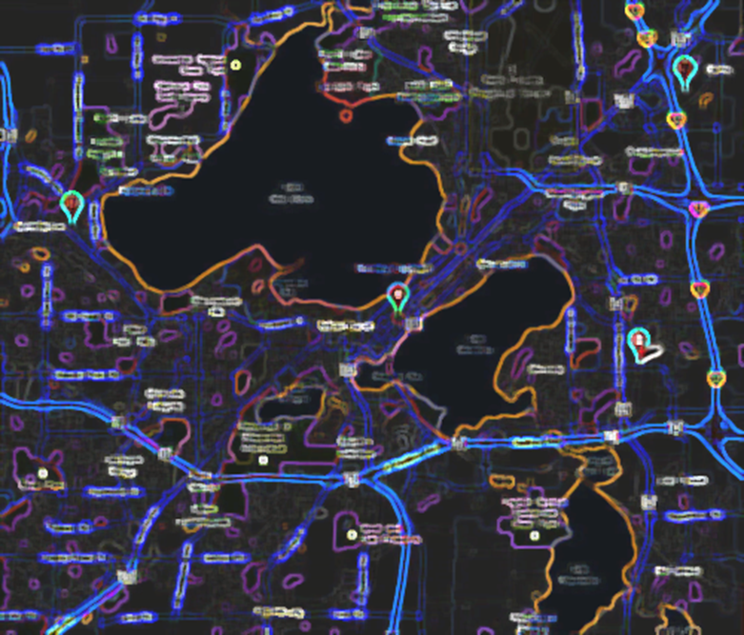
FRIDAY, APRIL 6TH
WSPS SCAVENGER
HUNT SOCIAL
5-6:30 P.M.
MEET IN SOP ATRIUM
END AT MEM UNION TERRACE FOR SOCIAL

Slide 13
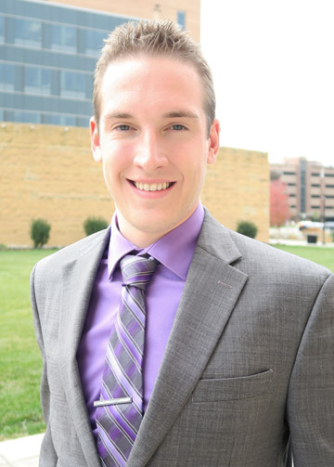
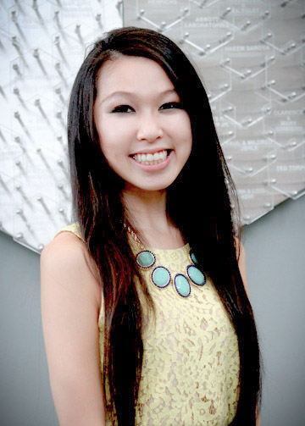
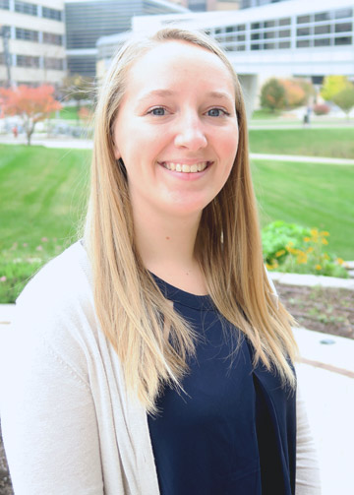
MRM Committee Chairs
Michael Heltne
Promotions &
Advertising
Graham
Edwardson
Exhibitors & Expo
Angie Ngo
Social & Welcoming
Clare Procknow
Registration

Slide 14
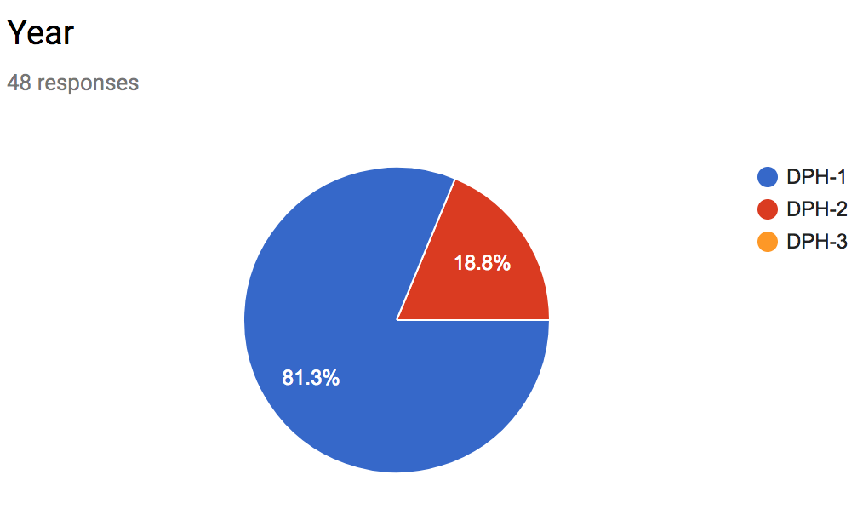
MRM Committee Sign Up
Deadline is March 15th by 11:59PM
Current Breakdown
DPH-2 – 9
DPH-1 – 39

Slide 15
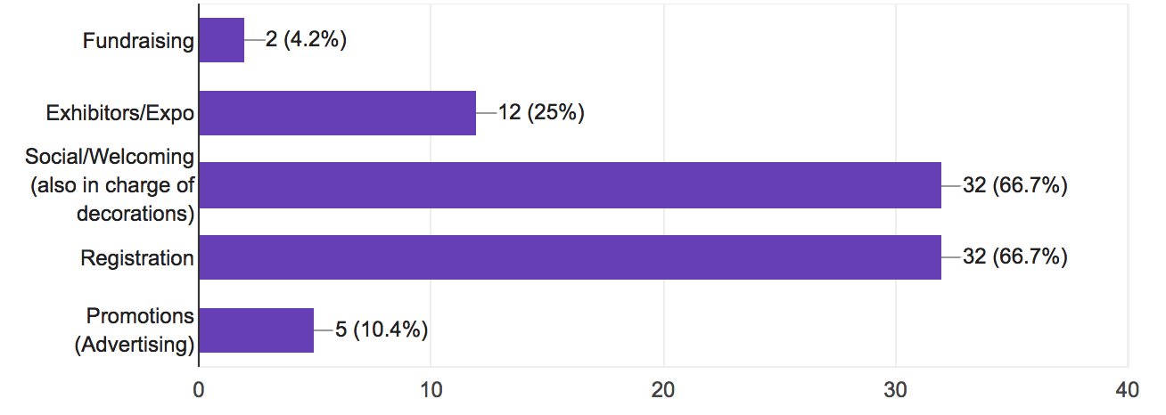
MRM Committee Sign Up
Deadline is March 15th by 11:59PM
Current Interest Breakdown

Slide 16
Why Should I get Involved?
Great CV Booster
Unique Conference (Ran by Students for Students)
Network with Students in our Region
Hosted by WSPS
In Madison WI!!
Deadline is March 15th by 11:59PM
MRM Date – most likely in November

Slide 17
“90 Second Policy Challenge: March 2018”
Eric’s Current Running Statistics:
3/7 Success=43%
Last Trial’s Error: +5s
Average Time: 98.5s Average Error: +13.5s
Standard Deviation: 8.88s
Eric’s Last Attempt
60 second policy challenge
Result : 86 Seconds
Drew’s Current Running Statistics:
Success=???
Last Trial’s Error: N/A
Average Time: N/A
Error: N/A
Standard Deviation: N/A
Will I be able to beat Eric’s Average “90 second challenge” of 98.5s?
Yes, easily
No way, you’re new to this

Slide 18
“90 Second Policy Challenge: March 2018”
State:
PDMP
Federal:
CI & CII quotas
‘Right-to-try’ Legislation
Other States:
NY consumer prescription drugs protection.
Gag Clause
45 Seconds Up
Time Up!

